Slide 1
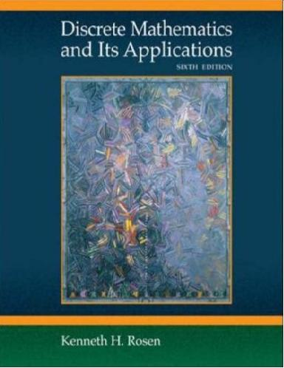
Chapter 11 (Part 1):
Boolean Algebra
Boolean Functions (11.1)
Representing Boolean Functions (11.2)
Logic Gates (11.3)
© by Kenneth H. Rosen, Discrete Mathematics & its Applications, Sixth Edition, Mc Graw-Hill, 2007

Slide 2
It has started from the book titled “The laws of thought” written by George Boole in 1854
Claude Shannon showed how the basic rules of logic could be used to design circuits
The circuit in electronic devices have inputs, each of which is either 0 or 1 and produce outputs that are also 0 or 1
Dr. Djamel Bouchaffra
CSE 504 Discrete Structures & Foundations of Computer Science. Ch. 10 (Part 1): Boolean Algebra
Notes:
CSE 504 Discrete Structures & Foundations of Computer Science
Dr. Djamel Bouchaffra
Ch.10 (Part 1) [Sections 10.1, 10.2, 10.3 & 10.4]: Boolean Algebra &

Slide 3
The operation of a circuit is defined by a Boolean function that specifies the value of an output for each set of inputs
One of the goal is to describe methods for finding a simplified expression (min number of sums and products) that represents a Boolean function (Karnaugh maps).
Dr. Djamel Bouchaffra
CSE 504 Discrete Structures & Foundations of Computer Science. Ch. 10 (Part 1): Boolean Algebra

Slide 4
Boolean Functions (11.1)
Introduction
  Electronic and optimal switches are studied using the set {0, 1} and the rules of Boolean algebra
  The 3 operations in Boolean algebra that are used are Complementation, Boolean Sum and the Boolean Product
Dr. Djamel Bouchaffra
CSE 504 Discrete Structures & Foundations of Computer Science. Ch. 10 (Part 1): Boolean Algebra

Slide 5

Boolean Functions (11.1) (cont.)
  Complement of an element is defined by:
  Boolean sum denoted by + or by OR obeys:
  1 + 1 = 1, 1+ 0 = 1, 0 + 1 = 1, 0 + 0 = 0
  Boolean product denoted by AND obeys:
  1 . 1 = 1, 1 . 0 = 0, 0 . 1 = 0, 0 . 0 = 0.
Dr. Djamel Bouchaffra
CSE 504 Discrete Structures & Foundations of Computer Science. Ch. 10 (Part 1): Boolean Algebra

Slide 6


Boolean Functions (11.1) (cont.)
  Example: Find the value
  Solution:
Boolean expressions & Boolean Functions
  Definition
  Let B = {0, 1} then B^{n} = {(x₁, x₂, …, x_{n}) such that x_{i} ∈ B for 1 ≤ i ≤ n}. The variable x is called a Boolean variable if it assumes values only from B (0 or 1). A function B^{n} to B is called a Boolean function of degree n.
Dr. Djamel Bouchaffra
CSE 504 Discrete Structures & Foundations of Computer Science. Ch. 10 (Part 1): Boolean Algebra

Slide 7


Boolean Functions (11.1) (cont.)
  Example: The function from
  B² ={(x, y) such that (x, y) ∈ {0, 1} * {0,1)} is a Boolean function with:
  F(1, 1) = 0, F(1, 0) = 1, F(0, 1) = 0, F(0, 0) = 0
  Example: Find the values of the Boolean function represented by
  Solution: The values of this function are displayed on the following table:
Dr. Djamel Bouchaffra

Slide 8

Boolean Functions (11.1) (cont.)
x | y | z | xy
1 1 1 1 0 0 0 0 | 1 1 0 0 1 1 0 0 | 1 0 1 0 1 0 1 0 | 1 1 0 0 0 0 0 0 | 0 1 0 1 0 1 0 1 | 1 1 0 1 0 1 0 1
Dr. Djamel Bouchaffra
CSE 504 Discrete Structures & Foundations of Computer Science. Ch. 10 (Part 1): Boolean Algebra

Slide 9




Identities of Boolean algebra
Identity | Name
 | Law of the double component
x + x = x x . x = x | Idempotent laws
x + 0 = x x . 1 = x | Identity laws
x + 1 = 1 x . 0 = 0 | Domination laws
x + y = y + x xy = yx | Commutative laws
x + (y + z) = (x + y) + z x(yz) = (xy)z | Associative laws
x + yz = (x + y) (x + z) | Distributive laws
 | De Morgan’s laws
x + xy = x x(x + y) = x | Absorption laws
 | Unit property
 | Zero property
Dr. Djamel Bouchaffra

Slide 10
Boolean Functions (11.1) (cont.)
  Example: Show that the distributive law
  x(y + z) = xy + xz
  Solution:
x | y | z | y + z | xy | xz | x(y + z) | xy + xz
1 1 1 1 0 0 0 0 | 1 1 0 0 1 1 0 0 | 1 0 1 0 1 0 1 0 | 1 1 1 0 1 1 1 0 | 1 1 0 0 0 0 0 0 | 1 0 1 0 0 0 0 0 | 1 1 1 0 0 0 0 0 | 1 1 1 0 0 0 0 0
Dr. Djamel Bouchaffra
CSE 504 Discrete Structures & Foundations of Computer Science. Ch. 10 (Part 1): Boolean Algebra

Slide 11


Boolean Functions (11.1) (cont.)
Duality
  Goal: the dual of a Boolean expression is obtained by interchanging Boolean sums and Boolean products and interchanging 0s and 1s
  Example: Find the duals of x (y + 0) and
  Solution: the duals are x + (y.1) and
Dr. Djamel Bouchaffra
CSE 504 Discrete Structures & Foundations of Computer Science. Ch. 10 (Part 1): Boolean Algebra

Slide 12
Boolean Functions (11.1) (cont.)
  The duality principle enables to obtain more identities. Since an identity between functions represented by Boolean expressions remains valid when the duals of both sides of the identity are taken
The abstract definition of a Boolean Algebra
  Goal: Recognize that a particular structure (set, propositions,…) is a Boolean algebra ⇒ all results of Boolean algebra will apply
Dr. Djamel Bouchaffra
CSE 504 Discrete Structures & Foundations of Computer Science. Ch. 10 (Part 1): Boolean Algebra

Slide 13
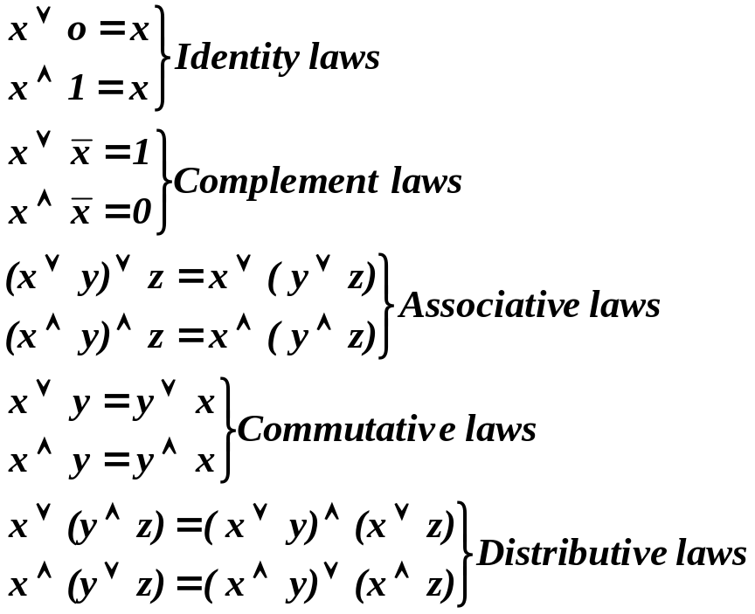
Boolean Functions (11.1) (cont.)
  Definition 1:
  A Boolean algebra is a set B with two binary operations ∨ and ∧, elements 0 and 1, and a unary operation ⁻ such that these properties hold for all x, y and z in B:

Slide 14
Boolean Functions (11.1) (cont.)
  The set of propositions in n variables, with the ∨ and ∧ operators, F and T, and the negation operator, also satisfies all the properties of a Boolean algebra
  Similarly, the set of subsets of a universal set Ω with the union and intersection operators, the empty set and the universal set, and the set complementation operator is a Boolean algebra
Dr. Djamel Bouchaffra
CSE 504 Discrete Structures & Foundations of Computer Science. Ch. 10 (Part 1): Boolean Algebra

Slide 15
Representing Boolean Functions (11.2)
Two problems of Boolean algebra are emphasized in this section
  Given the values of a Boolean function, how can a Boolean expression that represents this function be found?
  Is there a smaller set of operators that can be used to represent all Boolean functions?
Dr. Djamel Bouchaffra
CSE 504 Discrete Structures & Foundations of Computer Science. Ch. 10 (Part 1): Boolean Algebra

Slide 16
Representing Boolean Functions (11.2) (cont.)
Sum-of-products expansions
  Goal: Find a Boolean expression that represents a Boolean function
  Example: Find Boolean expressions that represent the functions F(x, y, z) and G(x, y, z) given by the following table:
x | y | z | F | G
1 1 1 1 0 0 0 0 | 1 1 0 0 1 1 0 0 | 1 0 1 0 1 0 1 0 | 0 0 1 0 0 0 0 0 | 0 1 0 0 0 1 0 0
Dr. Djamel Bouchaffra

Slide 17


Representing Boolean Functions (11.2) (cont.)
  Solution:
  To form the Boolean expressions for the function F(x,y,z), we need to look at the table and notice that F has the value 1 only if x = 1 and y = 0 and z =1 otherwise F has value 0
  ⇒ F(x,y,z) =
  To form the Boolean expression for the function G(x,y,z), we have to notice that
  G(x,y,z) = 1 ⇔ x = y = 1 and z = 0 or x = z = 0 and y = 1; otherwise G(x,y,z) = 0
  ⇒ G(x,y,z) =
x | y | z | F | G
1 1 1 1 0 0 0 0 | 1 1 0 0 1 1 0 0 | 1 0 1 0 1 0 1 0 | 0 0 1 0 0 0 0 0 | 0 1 0 0 0 1 0 0
Dr. Djamel Bouchaffra
CSE 504 Discrete Structures & Foundations of Computer Science. Ch. 10 (Part 1): Boolean Algebra

Slide 18
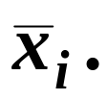
Representing Boolean Functions (11.2) (cont.)
  Definition 1:
  A literal is a Boolean variable or its complement. A minterm of the Boolean variables x1=, x₂, …, x_{n} is a Boolean product y₁y₂…y_{n,} where y_{i} = x_{i} or y_{i} = Hence, a minterm is a product of n literals, with one literal of each variable.
  The minterm y₁y₂…y_{n,} is 1 if and only if each y_{i} is 1, and therefore x_{i} = 1 when y_{i} = x_{i} and x_{i} = 0 when y_{i} =
Dr. Djamel Bouchaffra
CSE 504 Discrete Structures & Foundations of Computer Science. Ch. 10 (Part 1): Boolean Algebra

Slide 19
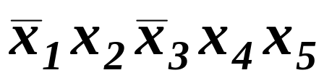
Representing Boolean Functions (11.2) (cont.)
  Example: Find a minterm that equals 1 if
  x₁ = x₃ = 0 and x₂ = x₄ = x₅ = 1, and equals 0 otherwise
  Solution: The minterm is:
  Minterms are used to determine the Boolean expression of a Boolean function in a table
Dr. Djamel Bouchaffra
CSE 504 Discrete Structures & Foundations of Computer Science. Ch. 10 (Part 1): Boolean Algebra

Slide 20
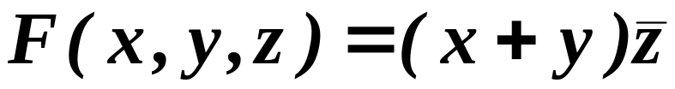
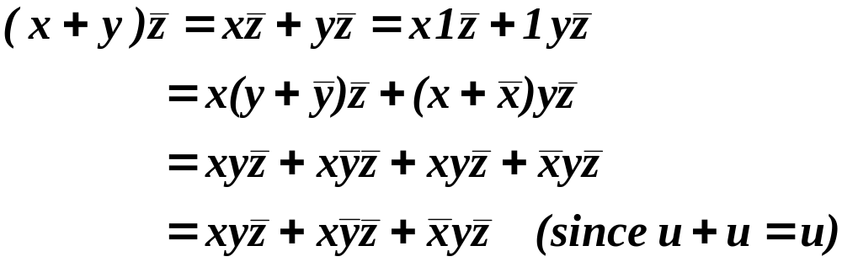
Representing Boolean Functions (11.2) (cont.)
  Example: Find the sum-of-products expansion for the function
  Solution (1):
Dr. Djamel Bouchaffra
CSE 504 Discrete Structures & Foundations of Computer Science. Ch. 10 (Part 1): Boolean Algebra

Slide 21
Representing Boolean Functions (11.2) (cont.)
  Solution (2): We use the minterm technique from a table
x | y | z | x + y |  | (x + y)
1 1 1 1 0 0 0 0 | 1 1 0 0 1 1 0 0 | 1 0 1 0 1 0 1 0 | 1 1 1 1 1 1 0 0 | 0 1 0 1 0 1 0 1 | 0 1 0 1 0 1 0 0
Dr. Djamel Bouchaffra
CSE 504 Discrete Structures & Foundations of Computer Science. Ch. 10 (Part 1): Boolean Algebra

Slide 22

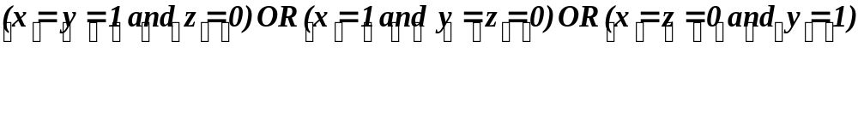



Representing Boolean Functions (11.2) (cont.)
  We need only to spot the set of values (x,y,z) for which This set is:
  {(1,1,0);(1,0,0);(0,1,0)}
  We need to find the minterm that equals 1 if
  Theorem 1: Every Boolean function can be represented using the three Boolean operators ., +, and – (complement)
₊
₊
Dr. Djamel Bouchaffra
CSE 504 Discrete Structures & Foundations of Computer Science. Ch. 10 (Part 1): Boolean Algebra

Slide 23
Representing Boolean Functions (11.2) (cont.)
Functional completeness
  The set{., +, ⁻} is functionally complete because of theorem 1
  Question: Can we find a smaller set of functionally complete operators?
  We answer “yes” to this question if one of the three operators can be expressed in terms of the other two
  One of the De Morgan’s laws provide the solution:
Dr. Djamel Bouchaffra
CSE 504 Discrete Structures & Foundations of Computer Science. Ch. 10 (Part 1): Boolean Algebra

Slide 24
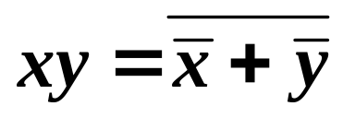
Representing Boolean Functions (11.2) (cont.)
  Similarly, we have:
  Finally, we have found a smaller set functionally complete; it contains only 2 operators!
  Question: Can we still reduce the set to only one operator? The answer is “yes”.
  Indeed, there are 2 sets that contain only one operator, they are: the NAND and the NOR.
Dr. Djamel Bouchaffra
CSE 504 Discrete Structures & Foundations of Computer Science. Ch. 10 (Part 1): Boolean Algebra

Slide 25

Representing Boolean Functions (11.2) (cont.)
  NAND ( | ) is defined as
  1|1 = 0 and 1|0 = 0|1= 0| =1
  NOR (↓) is defined as
  1↓1 = 1↓0 = 0↓1 = 0 and 0↓0 =1
  Since the set {., ⁻} is functionally complete and
  = x|x, xy = (x|y) | (x|y) then the set {|} is functionally complete.
  Home-exercise: Prove that the set {↓} is functionally complete.
Dr. Djamel Bouchaffra
CSE 504 Discrete Structures & Foundations of Computer Science. Ch. 10 (Part 1): Boolean Algebra

Slide 26
Logic Gates (11.3)
Introduction
  A computer, or electronic devices, is made up of a number of circuits
  Each circuit can be designed using the rules of Boolean algebra
  The basic element of circuits are called gates
  Each type of gates implements a Boolean Operation
Dr. Djamel Bouchaffra
CSE 504 Discrete Structures & Foundations of Computer Science. Ch. 10 (Part 1): Boolean Algebra

Slide 27
Logic Gates (11.3) (cont.)
  All circuits studied in this chapter provides output that depends only on the input, and not on the current state of the circuit
  These circuits that have no memory capabilities are called combinational circuits or gating networks
  Combinatorial circuits are built using 3 types of elements: (1) inverter, (2) OR gate,
  and (3) AND gate
Dr. Djamel Bouchaffra
CSE 504 Discrete Structures & Foundations of Computer Science. Ch. 10 (Part 1): Boolean Algebra

Slide 28
Logic Gates (11.3) (cont.)
  Role of each type of elements:
  Inverter: it accepts the value of one Boolean variable as input and produces the complement of this value as its output.
x
Dr. Djamel Bouchaffra
CSE 504 Discrete Structures & Foundations of Computer Science. Ch. 10 (Part 1): Boolean Algebra

Slide 29
Logic Gates (11.3) (cont.)
  OR gate: it accepts as input values of 2 or more Boolean variables. The output is the Boolean sum of their values
x
y
x + y
Dr. Djamel Bouchaffra
CSE 504 Discrete Structures & Foundations of Computer Science. Ch. 10 (Part 1): Boolean Algebra

Slide 30
Logic Gates (11.3) (cont.)
  AND gate: The inputs to this gate are the values of two or more Boolean variables. The output is the Boolean product of their values.
x
xy
y
Dr. Djamel Bouchaffra
CSE 504 Discrete Structures & Foundations of Computer Science. Ch. 10 (Part 1): Boolean Algebra

Slide 31
Logic Gates (11.3) (cont.)
  We can have multiple inputs to AND and OR:
x₁
x₂
…
x₁x₂…x_{n}
x_{n}
x₁
x₂
…
x₁ + x₂ + …+ x_{n}
x_{n}
Gates with n inputs
Dr. Djamel Bouchaffra
CSE 504 Discrete Structures & Foundations of Computer Science. Ch. 10 (Part 1): Boolean Algebra

Slide 32
Logic Gates (11.3) (cont.)
Combinations of Gates
  Combinational circuits can be constructed using a combination of inverters, OR gates, and AND gates
  When combinations of circuits are formed, some gates may share input using branching
  The following figure shows 2 ways of drawing the same circuit
Dr. Djamel Bouchaffra
CSE 504 Discrete Structures & Foundations of Computer Science. Ch. 10 (Part 1): Boolean Algebra

Slide 33


x
xy
y
x
y
x
xy
y
Two ways to draw the same circuit

Slide 34
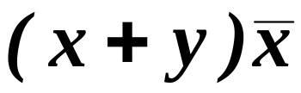
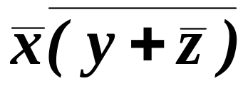
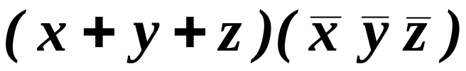
Logic Gates (11.3) (cont.)
  Example: Construct circuits that produce the following outputs:
Dr. Djamel Bouchaffra
CSE 504 Discrete Structures & Foundations of Computer Science. Ch. 10 (Part 1): Boolean Algebra

Slide 35
Logic Gates (11.3) (cont.)
  Solution for (a):
x
x + y
y
xy
x
Dr. Djamel Bouchaffra
CSE 504 Discrete Structures & Foundations of Computer Science. Ch. 10 (Part 1): Boolean Algebra

Slide 36


Logic Gates (11.3) (cont.)
  Solution for (b):
x
y
z
Dr. Djamel Bouchaffra
CSE 504 Discrete Structures & Foundations of Computer Science. Ch. 10 (Part 1): Boolean Algebra

Slide 37


Logic Gates (11.3) (cont.)
  Solution for (c):
x
y
z
x + y + z
x
y
z
Dr. Djamel Bouchaffra
CSE 504 Discrete Structures & Foundations of Computer Science. Ch. 10 (Part 1): Boolean Algebra

Slide 38
Logic Gates (11.3) (cont.)
Example of circuits
  Example: A committee of 3 individuals decides issues for an organization. Each individual votes either yes or no for each proposal that arises. A proposal is passed if it receives at least 2 yes votes. Design a circuit that determines whether a proposal passes.
  Solution: We want to have the following Boolean function: xy + xz + yz represented by the following circuit:
Dr. Djamel Bouchaffra
CSE 504 Discrete Structures & Foundations of Computer Science. Ch. 10 (Part 1): Boolean Algebra

Slide 39
Logic Gates (11.3) (cont.)
x
xy
y
x
xz
z
xy + xz + yz
y
yz
z
A circuit for majority voting
Dr. Djamel Bouchaffra
CSE 504 Discrete Structures & Foundations of Computer Science. Ch. 10 (Part 1): Boolean Algebra

Slide 40
Chapter 11 (Part 2):
Boolean Algebra
Logic Gates (11.3) (cont.)
Minimization of Circuits (11.4)
© by Kenneth H. Rosen, Discrete Mathematics & its Applications, Sixth Edition, Mc Graw-Hill, 2007

Slide 41
Chapter 9 (Part 2): Graphs
Graph Terminology (9.2) (cont.)
Representing Graphs &
Graph Isomorphism (9.3)
Connectivity (9.4)
Notes:
CSE 504 Discrete Structures & Foundations of Computer Science
Dr. Djamel Bouchaffra
Ch. 8 (Part 2: Sections 8.2 (cont.), 8.3 & 8.4 ): Graphs

Slide 42
Graph Terminology (9.2) (cont.)
Some special simple graphs
  Complete graph
  They are denoted by K_{n}, they contain exactly one edge between each pair of distinct vertices
Dr. Djamel Bouchaffra
CSE 504 Discrete Structures & Foundations of Computer Science, Ch. 8 (part 2): Graphs

Slide 43
Graph Terminology (9.2) (cont.)
K₁
K₂
K₃
K₄
The graphs K_{n} for
1 ≤ n ≤ 6
K₅
K₆
Dr. Djamel Bouchaffra
CSE 504 Discrete Structures & Foundations of Computer Science, Ch. 8 (part 2): Graphs

Slide 44
Graph Terminology (9.2) (cont.)
  Cycles
  They are denoted by C_{n}(n ≥ 3): they consist of n vertices v₁, v₂, …, v_{n} and edges {v₁, v₂}, {v₂, v₃}, …, {v_{n}, v_{n-1}} and {v_{n}, v₁}
Dr. Djamel Bouchaffra
CSE 504 Discrete Structures & Foundations of Computer Science, Ch. 8 (part 2): Graphs

Slide 45
Graph Terminology (9.2) (cont.)
C₃
C₄
The cycles
C₃, C₄, C₅ & C₆
C₅
C₆
Dr. Djamel Bouchaffra
CSE 504 Discrete Structures & Foundations of Computer Science, Ch. 8 (part 2): Graphs

Slide 46
Graph Terminology (9.2) (cont.)
  Wheels
  They are denoted by W_{n}; they are obtained by adding a vertex to the graphs C_{n} and connect this vertex to all vertices
Dr. Djamel Bouchaffra
CSE 504 Discrete Structures & Foundations of Computer Science, Ch. 8 (part 2): Graphs

Slide 47
Graph Terminology (9.2) (cont.)
W₃
W₄
The Wheels W₃,
W₄, W₅ & W₆
W₅
W₆
Dr. Djamel Bouchaffra
CSE 504 Discrete Structures & Foundations of Computer Science, Ch. 8 (part 2): Graphs

Slide 48
Graph Terminology (9.2) (cont.)
  n-cubes
  They are denoted by Q_{n}, they are graphs that have vertices representing the 2^{n} bit strings of length n.
  Two vertices are adjacent if and only if the bits strings that they represent differ in exactly one bit position
Dr. Djamel Bouchaffra
CSE 504 Discrete Structures & Foundations of Computer Science, Ch. 8 (part 2): Graphs

Slide 49
Graph Terminology (9.2) (cont.)
110
111
10
11
101
100
010
011
0
1
00
01
000
001
Q₁
Q₂
Q₃
The n-cube Q_{n} for n = 1, 2, and 3.
Dr. Djamel Bouchaffra
CSE 504 Discrete Structures & Foundations of Computer Science, Ch. 8 (part 2): Graphs

Slide 50
Graph Terminology (9.2) (cont.)
Bipartite graph
  Definition 5:
  A simple graph is called bipartite if its vertex set V can be partitioned into 2 disjoint sets V₁ and V₂ such that every edge in the graph connects a vertex in V₁ and a vertex in V₂ (so that no edge in G connects either 2 vertices in V₁ or 2 vertices in V₂).
Dr. Djamel Bouchaffra
CSE 504 Discrete Structures & Foundations of Computer Science, Ch. 8 (part 2): Graphs

Slide 51
Graph Terminology (9.2) (cont.)
  Example: C₆ is bipartite, since its vertex set can be partitioned into the 2 sets V₁ = {v₁, v₃, v₅} and V₂ = {v₂, v₄, v₆}, and every edge of C₆ connects a vertex in V₁ and a vertex in V₂.
  Example: K₃ is not bipartite. Why?
V₁
V₂
v₁
v₂
v₃
v₄
v₅
v₆
Dr. Djamel Bouchaffra
CSE 504 Discrete Structures & Foundations of Computer Science, Ch. 8 (part 2): Graphs

Slide 52
Graph Terminology (9.2) (cont.)
  Characterization of bipartite graph
    A graph is bipartite if and only if it is possible to color the vertices of the graph with at most 2 colors so that no 2 adjacent vertices have the same color
    Example: Complete bipartite graphs: they are denoted by K_{m,n}. Their vertices set is partitioned into 2 subsets of m and n vertices, respectively. There is an edge between 2 vertices if and only if one vertex is in the first subset and the other vertex is in the second subset.
Dr. Djamel Bouchaffra
CSE 504 Discrete Structures & Foundations of Computer Science, Ch. 8 (part 2): Graphs

Slide 53
Graph Terminology (9.2) (cont.)
K_{2,3}
K_{3,3}
K_{3,5}
K_{2,6}
Some complete bipartite graphs
Dr. Djamel Bouchaffra
CSE 504 Discrete Structures & Foundations of Computer Science, Ch. 8 (part 2): Graphs

Slide 54
Graph Terminology (9.2) (cont.)
Some applications of special types of graphs
  Local area network
  Goal: connecting computers as well as peripheral devices in a building using a local area network topology
  Some of these networks are based on a star topology, where all devices are connected to a central control device
  The star topology is equivalent to a K_{1,n} complete bipartite graph
Dr. Djamel Bouchaffra
CSE 504 Discrete Structures & Foundations of Computer Science, Ch. 8 (part 2): Graphs

Slide 55
Graph Terminology (9.2) (cont.)
  Other local area networks use a ring topology ⇔ C_{n} graphs
  Finally, the hybrid topology which is equivalent to a W_{n} graph is also used
Dr. Djamel Bouchaffra
CSE 504 Discrete Structures & Foundations of Computer Science, Ch. 8 (part 2): Graphs

Slide 56
Graph Terminology (9.2) (cont.)
(a)
(b)
(c)
Star, ring, and hybrid topologies for local area networks
Dr. Djamel Bouchaffra
CSE 504 Discrete Structures & Foundations of Computer Science, Ch. 8 (part 2): Graphs

Slide 57
Graph Terminology (9.2) (cont.)
  Interconnection networks for parallel processing
    Linear arrays for processor connection
    Mesh network (Markovian neighborhood)
    Hypercube interconnection (generalization of n-cubes)
Dr. Djamel Bouchaffra
CSE 504 Discrete Structures & Foundations of Computer Science, Ch. 8 (part 2): Graphs

Slide 58
Representing Graphs & Graph Isomorphism
Introduction
  Goal: Consists of choosing the most convenient representation of a graph
  We need to determine whether 2 graphs are isomorphic, this problem is important in graph theory
Dr. Djamel Bouchaffra
CSE 504 Discrete Structures & Foundations of Computer Science, Ch. 8 (part 2): Graphs

Slide 59
Representing Graphs & Graph Isomorphism (9.3) (cont.)
Representing Graph
  List all the edges of the graph (no multiple edges)
  Use adjacency list, which specifies the vertices that are adjacent to each vertex of the graph
Dr. Djamel Bouchaffra
CSE 504 Discrete Structures & Foundations of Computer Science, Ch. 8 (part 2): Graphs

Slide 60
Representing Graphs & Graph Isomorphism (9.3) (cont.)
  Example: Use adjacency lists to describe this simple graph.
b
a
c
e
d
Vertex | Adjacent vertices
a b c d e | b, c, e a a, d, e c, e a, c, d
Solution:
Dr. Djamel Bouchaffra
CSE 504 Discrete Structures & Foundations of Computer Science, Ch. 8 (part 2): Graphs

Slide 61
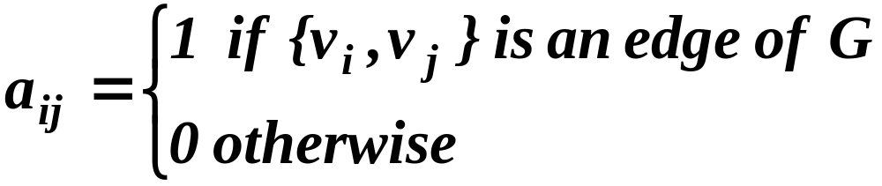
Representing Graphs & Graph Isomorphism (9.3) (cont.)
Adjacency matrices
  To simplify computation, graphs can be represented using matrices
    Adjacency matrix
    Incident matrix
  The adjacency matrix is defined as A = [a_{ij}] such that
Dr. Djamel Bouchaffra
CSE 504 Discrete Structures & Foundations of Computer Science, Ch. 8 (part 2): Graphs

Slide 62
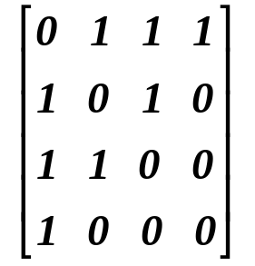
Representing Graphs & Graph Isomorphism (9.3) (cont.)
  Example: Use a adjacency matrix to represent this graph:
a
b
c
d
Solution: We order the vertices a, b, c, d.
The matrix representing this graph is
Dr. Djamel Bouchaffra
CSE 504 Discrete Structures & Foundations of Computer Science, Ch. 8 (part 2): Graphs

Slide 63
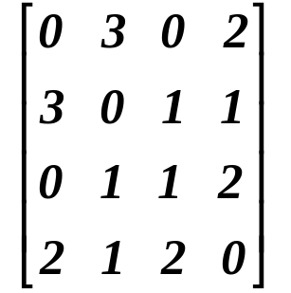
Representing Graphs & Graph Isomorphism (9.3) (cont.)
  In case of pseudographs , the adjacency matrix is not a binary matrix but is formed of elements that represent the number of edges between 2 vertices
  Example: Use an adjacency matrix to represent this pseudograph:
a
b
c
d
Solution: The adjacency matrix using
The ordering of vertices a, b, c, d is:
Dr. Djamel Bouchaffra
CSE 504 Discrete Structures & Foundations of Computer Science, Ch. 8 (part 2): Graphs

Slide 64
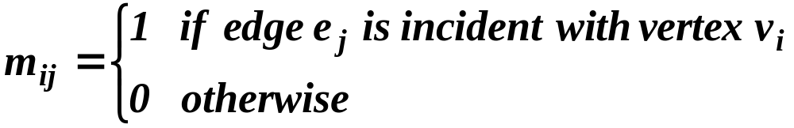
Representing Graphs & Graph Isomorphism (9.3) (cont.)
Incidence matrices
  Let G = (V,E) be an undirected graph.
  Incidence matrices are defined by the matrix
  M = [m_{ij}] such that
Dr. Djamel Bouchaffra
CSE 504 Discrete Structures & Foundations of Computer Science, Ch. 8 (part 2): Graphs

Slide 65
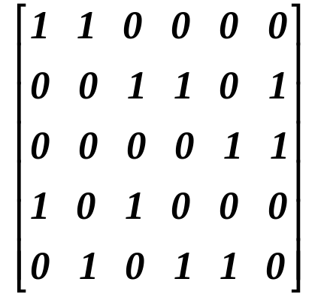
Representing Graphs & Graph Isomorphism (9.3) (cont.)
  Example: Using an incidence matrix, represent the following undirected graph:
v₁
v₂
e₆
v₃
e₂
e₄
e₁
e₅
e₃
v₄
v₅
e₁ e₂ e₃ e₄ e₅ e₆
v₁
v₂
v₃
v₄
v₅
Solution:
Dr. Djamel Bouchaffra
CSE 504 Discrete Structures & Foundations of Computer Science, Ch. 8 (part 2): Graphs

Slide 66
Representing Graphs & Graph Isomorphism (9.3) (cont.)
Isomorphism of graphs
  Goal: is it possible to draw 2 graphs in the same way?
  In chemistry, different graph compounds can have the same molecular formula but can differ in structure
  The graphs of these compounds cannot be drawn in the same way
  Graphs having the same structure share common properties
Dr. Djamel Bouchaffra
CSE 504 Discrete Structures & Foundations of Computer Science, Ch. 8 (part 2): Graphs

Slide 67
Representing Graphs & Graph Isomorphism (9.3) (cont.)
  Definition 1:
  The simple graphs G₁ = (V₁,E₁) and G₂ = (V₂,E₂) are isomorphic if there is a one-to-one and onto function f from V₁ to V₂ with the property that a and b are adjacent in G₁ if and only if f(a) and f(b) are adjacent in G₂, for all a and b in V₁. Such a function f is called an isomorphism.
Dr. Djamel Bouchaffra
CSE 504 Discrete Structures & Foundations of Computer Science, Ch. 8 (part 2): Graphs

Slide 68
Representing Graphs & Graph Isomorphism (9.3) (cont.)
  Example: Show that the graphs G = (V,E) and
  H = (W,F) are isomorphic
u₁
u₂
v₁
v₂
u₃
u₄
v₃
v₄
G
H
  Solution: The function f with f(u₁) = v₁, f(u₂) = v₄, f(u₃) = v₃, f(u₄) = v₂ is a one-to-one correspondence between V and W. To see that this correspondence preserves adjacency, note that adjacent vertices in G are u₁ and u₂, u₁ and u₃, u₂ and u₄, and u₃ and u₄, and each of the pairs f(u₁) = v₁ and f(u₂) = v₄, f(u₁) = v₁ and f(u₃) = v₃, f(u₂) = v₄ and
  f(u₃) = v₃, and f(u₁) = v₁ and f(u₄) = v₂ are adjacent in H.
Dr. Djamel Bouchaffra
CSE 504 Discrete Structures & Foundations of Computer Science, Ch. 8 (part 2): Graphs

Slide 69
Connectivity (9.4)
Goal: determination of paths within graphs
Many problems can be modeled with paths formed by traveling along the edges of graphs
Some examples of problems are:
  Study the link between remote computers
  Efficient planning of routes for mail delivery
  Garbage pickup
  Diagnostic in computer networks
Dr. Djamel Bouchaffra
CSE 504 Discrete Structures & Foundations of Computer Science, Ch. 8 (part 2): Graphs

Slide 70
Connectivity (9.4) (cont.)
Path
  Definition 1:
  Let n be a nonnegative integer and G an undirected graph. A path of length n from u to v in G is a sequence of n edges e₁, e₂, …, e_{n} of G such that f(e₁) = {x₀, x₁},
  f(e₂) = {x₁, x₂}, …, f(e_{n}) = {x_{n-1}, x_{n}}, where x₀ = u and x_{n} = v. When the graph is simple, we denote this path by its vertex sequence x₀, x₁, …, x_{n} (since listing these vertices uniquely determines the path). The path is a circuit if it begins and ends at the same vertex, that is, if u = v, and has length greater than zero. The path or circuit is said to pass through the vertices x₁, x₂, …, x_{n-1} or traverse the edges e₁, e₂, …, e_{n}. A path or circuit is simple if it does not contain the same edge more than once.
Dr. Djamel Bouchaffra
CSE 504 Discrete Structures & Foundations of Computer Science, Ch. 8 (part 2): Graphs

Slide 71
Connectivity (9.4) (cont.)
  Example:
  In this simple graph a, d, c, f, e is a simple path of length 4, since {a,d}, {d,c}, {c,f}, and {f,e} are all edges.
  However, d, e, c, a is not a path, since {e,c} is not an edge.
  Note that b, c, f, e, b is a circuit of length 4 since {b,c}, {c,f}, {f,e}, and {e,b} are edges, and this path begins and ends at b.
  The path a, b, e,d,a,b, which is of length 5, is not simple since it contains the edge {a,b} twice.
a
b
c
d
e
f
Dr. Djamel Bouchaffra
CSE 504 Discrete Structures & Foundations of Computer Science, Ch. 8 (part 2): Graphs

Slide 72
Connectivity (9.4) (cont.)
  Definition 2:
  Let n be a nonnegative integer and G a directed multigraph. A path of length n from u to v in G is a sequence of edges e₁, e₂, …, e_{n} of G such that f(e₁) = (x₀, x₁), f(e₂) = (x₁, x₂), …, f(e_{n}) = (x_{n-1}, x_{n}), where x₀ = u and x_{n} = v. When there are no multiple edges in the directed graph, this path is denoted by its vertex sequence x₀, x₁, …, x_{n}. A path of length greater than zero that begins and ends at the same vertex is called a circuit or cycle. A path or circuit is called simple it it does not contain the same edge more than once.
Dr. Djamel Bouchaffra
CSE 504 Discrete Structures & Foundations of Computer Science, Ch. 8 (part 2): Graphs

Slide 73
Connectivity (9.4) (cont.)
Connectedness in undirected graphs
  Question asked:
  When does a computer network have the property that every pair of computers can share information, if message can be sent through one or more intermediate computers?
  This question is equivalent to:
  When is there always a path between 2 vertices in the graph?
Dr. Djamel Bouchaffra
CSE 504 Discrete Structures & Foundations of Computer Science, Ch. 8 (part 2): Graphs

Slide 74
Connectivity (9.4) (cont.)
  Definition 3:
  An undirected graph is called connected if there is a path between every pair of distinct vertices of the graph
  Theorem 1:
  There is a simple path between every pair of distinct vertices of a connected undirected graph
  Proof: Exercise!
Dr. Djamel Bouchaffra
CSE 504 Discrete Structures & Foundations of Computer Science, Ch. 8 (part 2): Graphs

Slide 75
Connectivity (9.4) (cont.)
  A graph that is not connected is the union of two or more connected subgraphs, each pair of which has no vertex in common.
  These disjoint connected subgraphs are called the connected components of the graph
Dr. Djamel Bouchaffra
CSE 504 Discrete Structures & Foundations of Computer Science, Ch. 8 (part 2): Graphs

Slide 76
Connectivity (9.4) (cont.)
Connected in directed graphs
  Definition 4:
  A directed graph is strongly connected if there is a path from a to b and from b to a whenever a and b are vertices in the graph
  Definition 5:
  A directed graph is weakly connected if there is a path between every 2 vertices in the underlying undirected graph
Dr. Djamel Bouchaffra
CSE 504 Discrete Structures & Foundations of Computer Science, Ch. 8 (part 2): Graphs

Slide 77
Connectivity (9.4) (cont.)
  A directed graph is weakly connected ⇔ there is always a path between 2 vertices when the directions of the edges are ignored
  Strongly connected ⇒ weakly connected directed graph
Dr. Djamel Bouchaffra
CSE 504 Discrete Structures & Foundations of Computer Science, Ch. 8 (part 2): Graphs

Slide 78
Connectivity (9.4) (cont.)
  Example: Are the directed graphs G and H strongly connected?
a
b
a
b
c
c
G
H
e
d
e
d
  Solution: G is strongly connected because there is a path between any 2 vertices in this directed graph. Hence, G is also weakly connected.
  The graph H is not strongly connected. There is no directed path from a to b in this graph. However, H is weakly connected, since there is a path between any 2 vertices in their underlying undirected graph of H.
Dr. Djamel Bouchaffra
CSE 504 Discrete Structures & Foundations of Computer Science, Ch. 8 (part 2): Graphs

Slide 79
Connectivity (9.4) (cont.)
Paths & isomorphism
  Paths and circuits can help determine whether 2 graphs are isometric
  The existence of a simple circuit (or cycle) of a particular length is a useful invariant to show that 2 graphs are not isomorphic
Dr. Djamel Bouchaffra
CSE 504 Discrete Structures & Foundations of Computer Science, Ch. 8 (part 2): Graphs

Slide 80
Connectivity (9.4) (cont.)
  Example: Determine whether the graph G and H are isomorphic.
u₁
v₁
u₆
u₂
v₆
v₂
G
u₃
H
v₃
u₅
v₅
u₄
v₄
  Solution: Both G and H have 6 vertices and 8 edges. Each has 4 vertices of degree 3, and two vertices of degree 2. However, H has a simple circuit of length 3, namely, v₁, v₂, v₆, v₁ whereas G has no simple circuit of length 3, as can be determined by inspection (all simple circuits in G have length at least four). Since the existence of a simple circuit of length 3 is an isomorphic invariant, G and H are not isomorphic.
Dr. Djamel Bouchaffra
CSE 504 Discrete Structures & Foundations of Computer Science, Ch. 8 (part 2): Graphs

Slide 81
Connectivity (9.4) (cont.)
Counting paths between vertices
  Theorem 2:
  Let G be a graph with adjacency matrix A with respect to the ordering v₁, v₂, …, v_{n} (with directed or undirected edges, with multiple edges and loops allowed). The number of different paths of length r from v_{i} to v_{j}, where r is a positive integer is equals to the (i, j)th entry of A^{r}.
  Proof: Exercise!
Dr. Djamel Bouchaffra
CSE 504 Discrete Structures & Foundations of Computer Science, Ch. 8 (part 2): Graphs

Slide 82
Connectivity (9.4) (cont.)
  Example: How many paths of length 4 are there from a to d in the simple graph G?
a
b
d
c
G
Dr. Djamel Bouchaffra
CSE 504 Discrete Structures & Foundations of Computer Science, Ch. 8 (part 2): Graphs

Slide 83
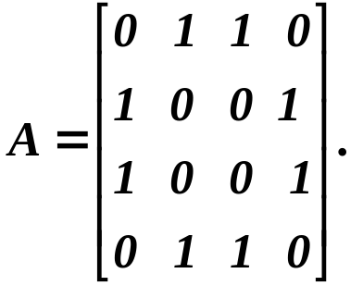
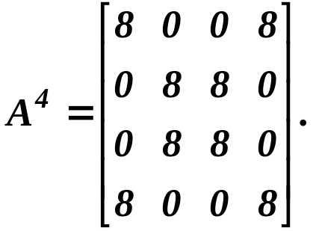
Connectivity (9.4) (cont.)
a
b
d
c
G
  Solution: The adjacency matrix of G (ordering the vertices as a, b, c, d) is
  Hence, the number of paths of length 4 from a to d is the (1,4)th entry of A⁴. Since
  there are exactly 8 paths of length 4 from a to d. By inspection of the graph, we see that a, b, a, b, d; a, b, a, c, d; a, b, d, b, d; a, b, d, c, d; a, c, a, b, d; a, c, a, c, d; a, c, d, b, d; and a, c, d, c, d are the 8 paths from a to d.
Dr. Djamel Bouchaffra
CSE 504 Discrete Structures & Foundations of Computer Science, Ch. 8 (part 2): Graphs

Slide 84
Logic Gates (11.3) (cont.)
Adders
  Question: How can we carry out operations such as additions of two positive integers (in binary expansion) using logic circuits?
  We first build a circuit that can be used to determine
  x + y where x and y are two bits
Input
Output
x | y | s | c
1 1 0 0 | 1 0 1 0 | 0 1 1 0 | 1 0 0 0
Dr. Djamel Bouchaffra
CSE 504 Discrete Structures & Foundations of Computer Science. Ch. 10 (Part 1): Boolean Algebra

Slide 85

Logic Gates (11.3) (cont.)
  The output consists of two bits s and c which are the sum bit and the carry bit respectively
  From the previous table, we can write:
    c = xy
Dr. Djamel Bouchaffra
CSE 504 Discrete Structures & Foundations of Computer Science. Ch. 10 (Part 1): Boolean Algebra

Slide 86

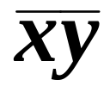
Logic Gates (11.3) (cont.)
  The following circuit called half adder illustrates the sum of two bits with carry
x
x + y
y
x
xy
y
Carry = xy
Dr. Djamel Bouchaffra
CSE 504 Discrete Structures & Foundations of Computer Science. Ch. 10 (Part 1): Boolean Algebra

Slide 87
  We need to compute the sum bit and the carry bit when two bits and a carry are added
  The inputs to this full adder are the bits x and y and the carry c_{i}
  The outputs are the sum bit s and the new carry c_{i+1}.
Input
Output
x | y | c_{i} | s | C_{i+ 1}
1 1 1 1 0 0 0 0 | 1 1 0 0 1 1 0 0 | 1 0 1 0 1 0 1 0 | 1 0 0 1 0 1 1 0 | 1 1 1 0 1 0 0 0
Dr. Djamel Bouchaffra
CSE 504 Discrete Structures & Foundations of Computer Science. Ch. 10 (Part 1): Boolean Algebra

Slide 88
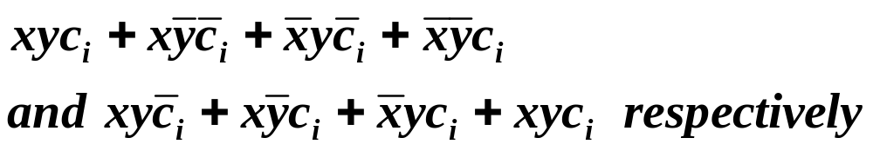
Logic Gates (11.3) (cont.)
  The two outputs of the full adder, the sum bit s and the carry c_{i+1} are given by the sum-of-products expansion
  The full adder circuit using half adders is depicted in the following picture
Dr. Djamel Bouchaffra
CSE 504 Discrete Structures & Foundations of Computer Science. Ch. 10 (Part 1): Boolean Algebra

Slide 89



Logic Gates (11.3) (cont.)
c_{i}
Half
adder
x
Half
adder
y
xy
A full adder
Dr. Djamel Bouchaffra
CSE 504 Discrete Structures & Foundations of Computer Science. Ch. 10 (Part 1): Boolean Algebra

Slide 90
Logic Gates (11.3) (cont.)
  Finally, the following figure shows how the half and the full adders can be combined to add the two three-bit integers (x₂x₁x₀)₂ and (y₂y₁y₀)₂ to produce the sum (s₃s₂s₁s₀)₂
x₀
Half
adder
s₀
c₀
y₀
Full
Adder
s₁
x₁
c_{i}
y₁
Full
Adder
s₂
x₂
y₂
c₂ = s₃
Dr. Djamel Bouchaffra
CSE 504 Discrete Structures & Foundations of Computer Science. Ch. 10 (Part 1): Boolean Algebra

Slide 91
Minimization of Circuits (11.4)
Introduction
  Goal: Representing circuits with Boolean expressions having fewer operations
  Example: a circuit has output 1 if and only if:
  x = y = z = 1 or x = z = 1 and y = 0. The sum-of-product of this circuit is:
  xz is a Boolean expression with fewer operators that represents the circuit
  Therefore, there are 2 different implementations of this circuit as depicted in the following picture
Dr. Djamel Bouchaffra
CSE 504 Discrete Structures & Foundations of Computer Science. Ch. 10 (Part 1): Boolean Algebra

Slide 92



Minimization of circuits (11.4) (cont.)
x
xyz
y
z
x
y
z
x
xz
z
Two circuits with the same output
Dr. Djamel Bouchaffra
CSE 504 Discrete Structures & Foundations of Computer Science. Ch. 10 (Part 1): Boolean Algebra

Slide 93
Minimization of circuits (11.4) (cont.)
Karnaugh maps
  Goal: reduce the number of terms in a Boolean expression representing a circuit
  Question: How can we find terms to combine for Boolean functions for a relatively small number of variables?
  Answer: There is a method introduced by Maurice Karnaugh in 1953 for fewer variables.
Dr. Djamel Bouchaffra
CSE 504 Discrete Structures & Foundations of Computer Science. Ch. 10 (Part 1): Boolean Algebra

Slide 94
Minimization of circuits (11.4) (cont.)
  K-map was designed in 1950 to help minimize circuits by hand
  K-maps are useful in the minimization of circuits with up to 6 variables only
  K-maps are inapplicable when dealing with 50, 100, or 1000 variables
  The minimization problem with respect to the number of variables is NP-complete
Dr. Djamel Bouchaffra
CSE 504 Discrete Structures & Foundations of Computer Science. Ch. 10 (Part 1): Boolean Algebra

Slide 95




Minimization of Circuits (11.4) (cont.)
  Principle
    K-maps for two variables:
      There are 4 possible minterms in the sum-of-product expansion of a Boolean function in 2 variables x and y
      Adjacent cells are those whose minterms differ in exactly one litteral as shown in the following figure.
      A k-map for a Boolean function in two variables consists of 4 cells, where a 1 is placed in the cell representing a minterm if this minterm is present in the expansion
y
x
xy
Dr. Djamel Bouchaffra
CSE 504 Discrete Structures & Foundations of Computer Science. Ch. 10 (Part 1): Boolean Algebra

Slide 96



Minimization of circuits (11.4) (cont.)
    Example: Find the K-maps for:
      Solution: We include a 1 in a cell when the minterm represented by this cell is present in the sum-of-products expansion.
y
y
y
x
1
1
x
 | 1
1
 | 1
1 | 1
x
(a)
(b)
(c)
Dr. Djamel Bouchaffra

Slide 97
Minimization of circuits (11.4) (cont.)
    Whenever there are 1’s in two adjacent cells, the minterms are combined into a product involving just one of the variables
    We circle blocks of cells in the K-maps that represent minterms that can be combined and then find the corresponding sum of the products
    The goal is to identify the largest possible blocks, and to cover all the 1s with the fewest blocks using the largest blocks first and always using the largest possible blocks.
Dr. Djamel Bouchaffra
CSE 504 Discrete Structures & Foundations of Computer Science. Ch. 10 (Part 1): Boolean Algebra

Slide 98

    Example: Simplify the following sum-of-products expansions:
      Solution: The grouping of minterms is shown in the following figure. Using the k-maps for these expansions Minimal expansions for these sums-of-products are:
      (a) y; (b) ; and (c) .
y
y
y
x
1
1
x
 | 1
1
 | 1
1 | 1
x
(a)
(b)
(c)
Dr. Djamel Bouchaffra
CSE 504 Discrete Structures & Foundations of Computer Science. Ch. 10 (Part 1): Boolean Algebra

Slide 99
Minimization of Circuits (11.4) (cont.)
  Conclusion:
    Within a block of adjacent cells, we need to take the common expression
    We need to sum minterms of all blocks.
Dr. Djamel Bouchaffra
CSE 504 Discrete Structures & Foundations of Computer Science. Ch. 10 (Part 1): Boolean Algebra

